Slide 1

Mental Health eScreening Clinician & Assistant Training

Slide 2
Welcome to MHE!
Mental Health eScreening (MHE) tablets present mental health assessments to newly registering OEF/OIF/OND Veterans who are willing to begin their initial data entry while still in the VA waiting room. The tablets capture Veterans’ data securely and confidentially.
Meanwhile, MHE provides a dashboard for clinicians to view the ongoing assessments, which tracks Veterans’ progress overall, and highlights those Veterans who need assistance to complete their assessments.
The MHE dashboard shows a real-time alert for any responses that exceed warning parameters, such as suicide indicators. This allows clinicians to single out and fast-track Veterans who may be undergoing a crisis but not displaying the outward signs of it.

Slide 3
MHE Research Pilot
For the last 2 years, the Center for Excellence in Stress and Mental Health (CESAMH) has been using eScreening for OEF/OIF/OND Veterans enrolling in VA Health Care in San Diego.
About half of the newly enrolled had risk factors for suicide, indicating the need for immediate clinical follow-up. Many Veterans had symptoms of depression and anxiety, and the majority were in physical pain.

Slide 4
Findings from the research pilot
MHE tablet-using Veterans had their screenings documented an average of 19 days sooner than the Veterans who used paper forms.
Almost all of the tablet-using Veterans who wanted help were able to speak with a clinician within 3 days, versus 2-3 months with the old system of paper forms.
MHE was preferred by both Clinicians and Veterans.

Slide 5
Conclusions
Clinical Care Improvements
timely triage to appropriate services (approximately 40% of Veterans need immediate follow-up with the Suicide Risk Assessment)
the ability to monitor treatment outcomes over time
increased encouragement of Veterans with immediate personalized feedback
greater overall Veterans’ satisfaction due to an increase in trust
Administrative Benefits
increased screening capacity (improved VA-mandated screening rates)
improved capability to monitor ongoing treatment outcomes (efficiency)
Reduced time needed for clinical care and documentation (cost savings), and
increased quality of care without increasing staff (cost savings).

Slide 6
MHE training notes
Notes that relate to the topic will appear under some slides.
Notes:
The notes will be here.

Slide 7
MHE Clinician & Assistant training
Access
Your tasks
What the Veteran sees
Creating assessments
The Assessment Dashboard
Searches
Reports
Getting help
Notes:
A self-review follows most topics.

Slide 8
Access
Security
Logging in and out
Verifying your CPRS account
Changing your password

Slide 9
Access Security
Staff will not be held responsible for tablets which are stolen or broken by a Veteran.
Tablets have built-in tracking.
Tablets won’t function outside of the hospital grounds.

Slide 10

Access Logging in and out
Notes:
Click Staff Login >.

Slide 11
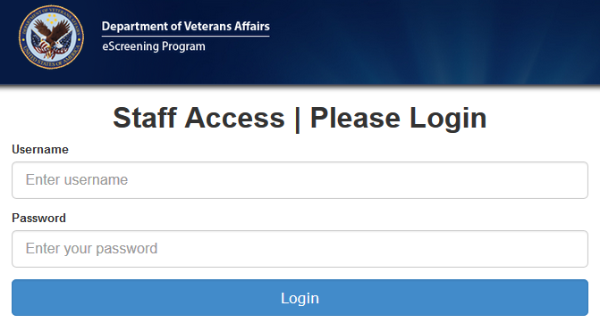
Access Logging in and out
Notes:
Clicking the Staff Login button brings you to this standard log-in page.
Type your username and password, then click Login.
Your Home page opens.

Slide 12

Access Logging in and out
Notes:
A logout link is always in the top right corner.
If you don’t interact with MHE for 20 minutes, it will log you out as a security precaution. If the system logs you out but you want to keep working, just log in again.

Slide 13
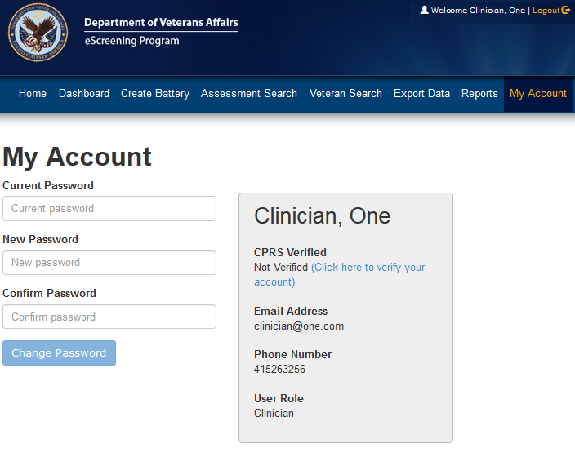
Access Verifying your CPRS account
Notes:
After logging in the first time, verify your account with CPRS. You only need to do this once.
Click the My Account tab.
Click (Click here to verify your account). A window pops up.

Slide 14
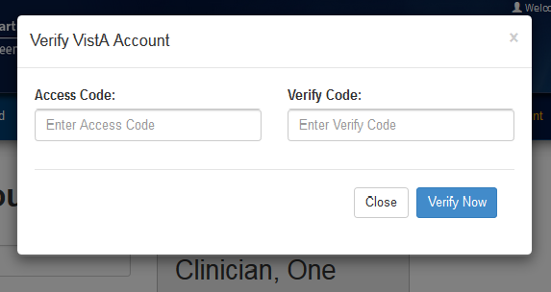
Access Verifying your CPRS account
Notes:
3. Type your Access and Verify codes, then click Verify Now.
The system confirms you are verified.

Slide 15
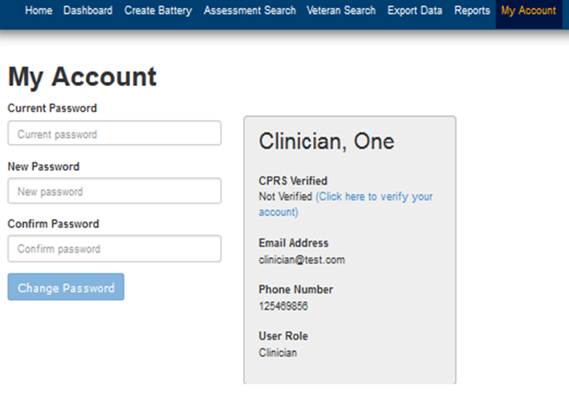
Access Changing your password
Update your password per VA guidelines.
Notes:
MHE’s password change is standard. As directed, type your current password, then the new one, and confirm. Then click Change Password. The system tells you your password has changed.

Slide 16
MHE Access Self-Review question
Regarding security, which statement below is false?
Staff will not be held responsible for tablets which are stolen or broken by a Veteran.
Staff on duty will be charged if a Veteran breaks a tablet.
Tablets have built-in tracking.
Tablets won’t function outside of the hospital grounds.

Slide 17
MHE Access Self-Review answer
Regarding security, which statement below is false?
Staff will not be held responsible for tablets which are stolen or broken by a Veteran.
Staff on duty will be charged if a Veteran breaks a tablet.
Tablets have built-in tracking.
Tablets won’t function outside of the hospital grounds.

Slide 18
MHE Access Self-Review question
Regarding access, what should you do if MHE logs you out?
Contact the Healthcare System Technical Administrator.
Try to log in again the next day.
Log in again whenever you are ready.
Update your password.

Slide 19
MHE Access Self-Review answer
Regarding access, what should you do if MHE logs you out?
Contact the Healthcare System Technical Administrator.
Try to log in again the next day.
Log in again whenever you are ready.
Update your password.

Slide 20
MHE Clinician & Assistant training
Access
Your tasks
What the Veteran sees
Creating assessments
The Assessment Dashboard
Searches
Reports
Getting help

Slide 21
Your tasks
Create assessments for Veterans to complete in the waiting room
Upload Veteran data to VistA
Monitor real-time alerts on the dashboard

Slide 22
MHE Clinician & Assistant training
Access
Your tasks
What the Veteran sees
Creating assessments
The Assessment Dashboard
Searches
Reports
Getting help

Slide 23

What the Veteran sees
Notes:
Veterans see the first screen that you did.

Slide 24
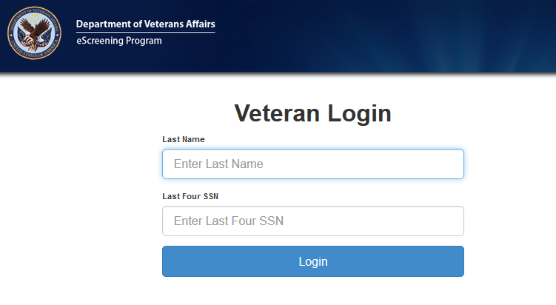
What the Veteran sees
Notes:
Their login page is similar to yours. Instead of a username, they type their last name, and their password is their last 4 social security numbers.

Slide 25
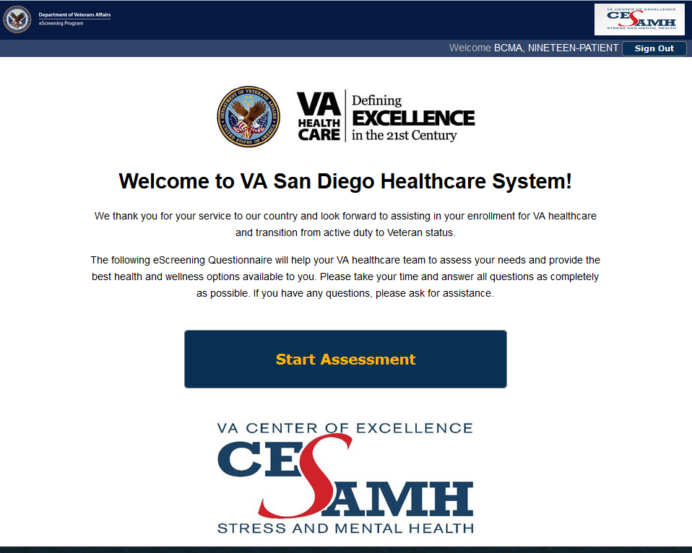
What the Veteran sees
Notes:
Your Healthcare System Technical Administrator will customize this page to reflect your site.
Veterans can touch the Start Assessment button to begin.

Slide 26
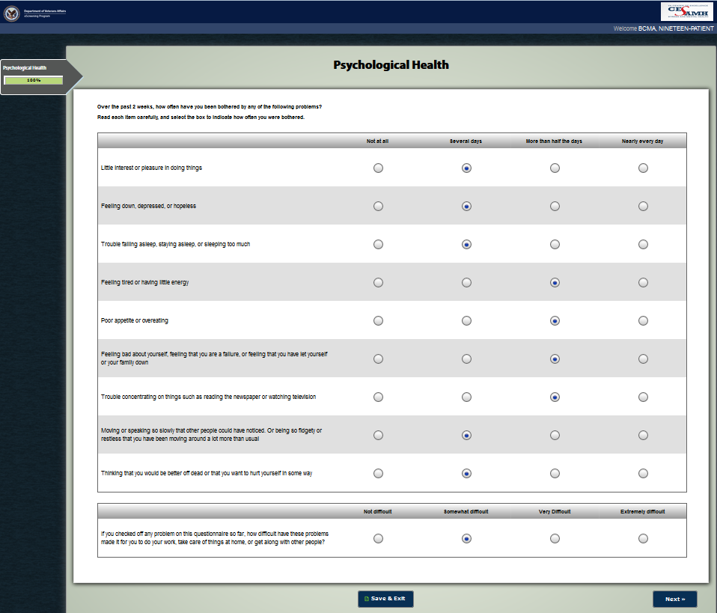
What the Veteran sees
Notes:
This is one page of a typical screening module.

Slide 27
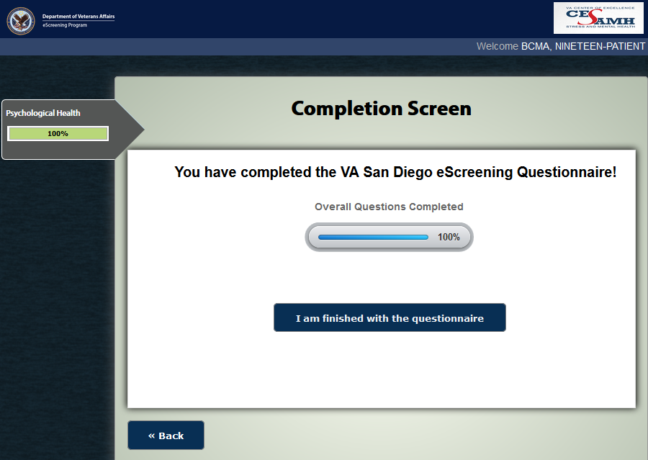
What the Veteran sees
Notes:
When finished, the Veteran is offered a ← Back button to review answers and an I am finished with the questionnaire button.

Slide 28
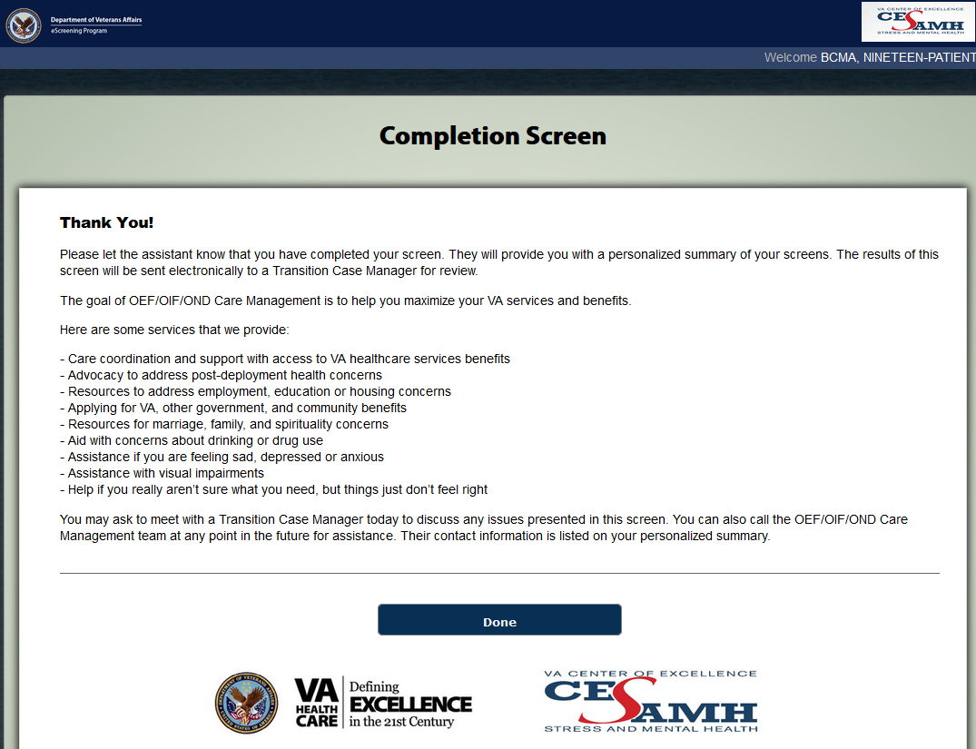
What the Veteran sees
Notes:
The I am finished … button gives way to this Completion screen.
The Veteran can touch the Done button to exit the session.
Your Healthcare System Technical Administrator can also customize this page for your site.

Slide 29
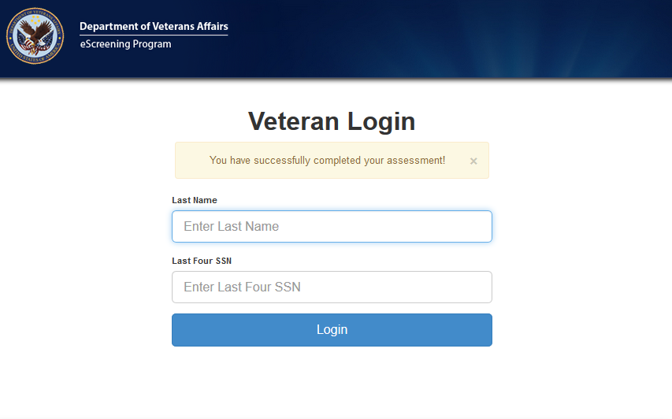
What the Veteran sees
Notes:
This page displays after a Veteran touches the Done button.
It depends on your site’s workflow, but this is usually where the Veteran hands the tablet back to VA personnel. MHE generates an eScreening Summary (“Veteran Summary”) to be printed and given to the Veteran. The summary is customized and offers support with problems the Veteran has reported.

Slide 30
MHE What the Veteran seeskklklj Self-Review question
Which statements are true about what the Veteran sees on the tablet?
Veterans share a welcome screen with clinical staff.
Veterans see a welcome screen which your site can customize.
Veterans can skip some questions and then use a Back button to revisit them before exiting the program.
Only 2 and 3 are true.

Slide 31
MHE What the Veteran seeskklklj Self-Review answer
Which statements are true about what the Veteran sees on the tablet?
Veterans share a welcome screen with clinical staff.
Veterans see a welcome screen which your site can customize.
Veterans can skip some questions and then use a Back button to revisit them before exiting the program.
Only 2 and 3 are true.

Slide 32
MHE Clinician & Assistant training
Access
Your tasks
What the Veteran sees
Creating assessments
The Assessment Dashboard
Searches
Reports
Getting help

Slide 33
Creating an assessment
Things to know
Creating for a walk-in Veteran
Creating by the batch, for appointments
Notes:
We’ll look at each of these items.

Slide 34
Creating an assessment Things to know
Batteries and assessments are the same thing.
A Veteran must have a record in the MHE database before you can create an assessment.
You can create single assessments for walk-in Veterans, or a batch for appointments.

Slide 35
Creating an assessment For a walk-in Veteran
Create or locate the Veteran’s record in the database.
Create the Veteran’s new assessment.
Notes:
We will explore both of these tasks next.

Slide 36
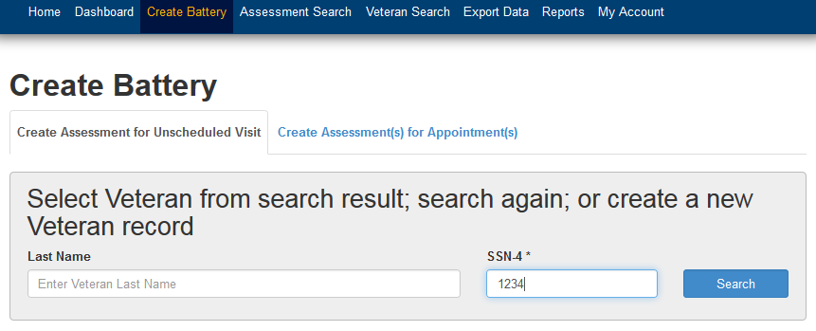
Creating an assessment For a walk-in Veteran
Notes:
A Veteran must have a record in the MHE database before you can create an assessment. If there isn’t any record, you must create one, but don’t worry, it’s quite simple.
We’ll start with a search, to see if someone has already created a record for the Veteran.
From the Home page, click Create Battery. The Create Battery page opens, as shown above.
Type the Veteran’s last 4 social security numbers, then click Search.

Slide 37
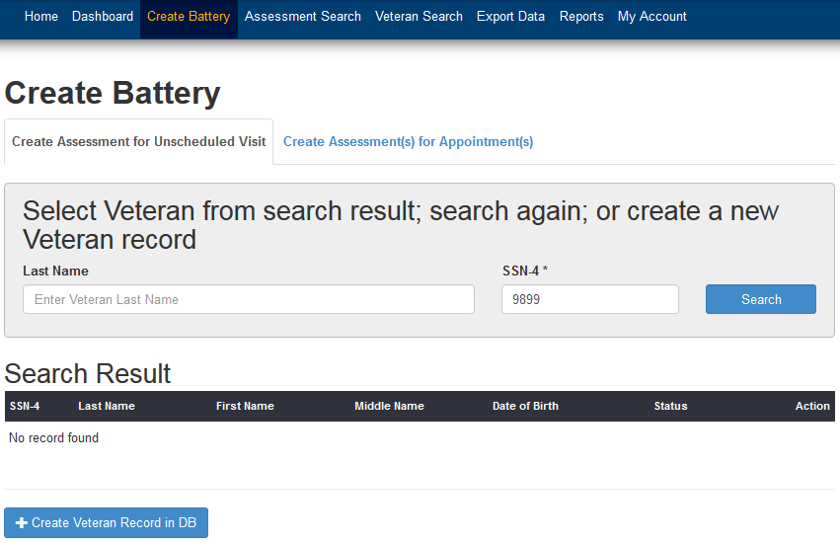
Creating an assessment For a walk-in Veteran
Notes:
As shown above, if the search returns no record found, you must create a Veteran record in the database.
Click +Create Veteran Record in DB.
The Create Veteran page opens.
--OR--
If the search returns the Veteran’s record, click the Create New Battery button and skip the next 2 slides.

Slide 38
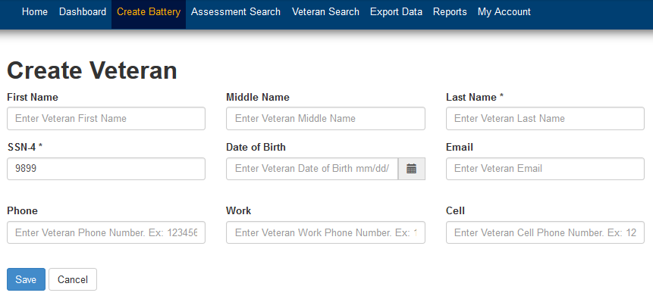
Creating an assessment For a walk-in Veteran
Notes:
Fill in the fields with the Veteran’s information (only the 2 fields with asterisks are mandatory), then click Save. The Veteran Detail page opens for the new record, showing a Create New Battery button.

Slide 39
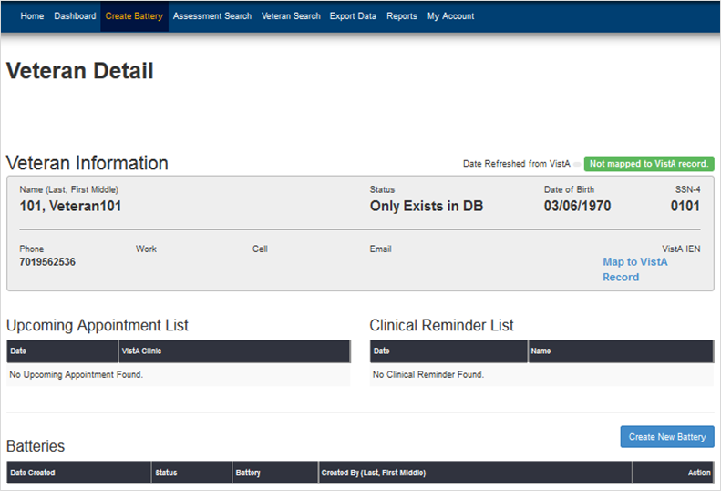
Creating an assessment For a walk-in Veteran
Notes:
Click Create New Battery.
The Create Battery page opens, showing the name of the Veteran record you just created (or had located previously).

Slide 40
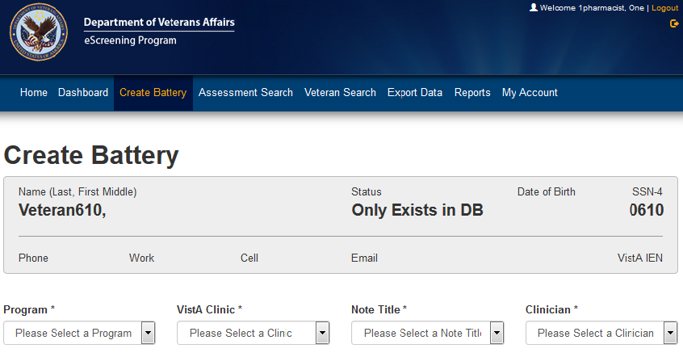
Creating an assessment For a walk-in Veteran
Notes:
Select from the drop-down lists.
The Create Battery form will unfold, showing option buttons on the left side.

Slide 41
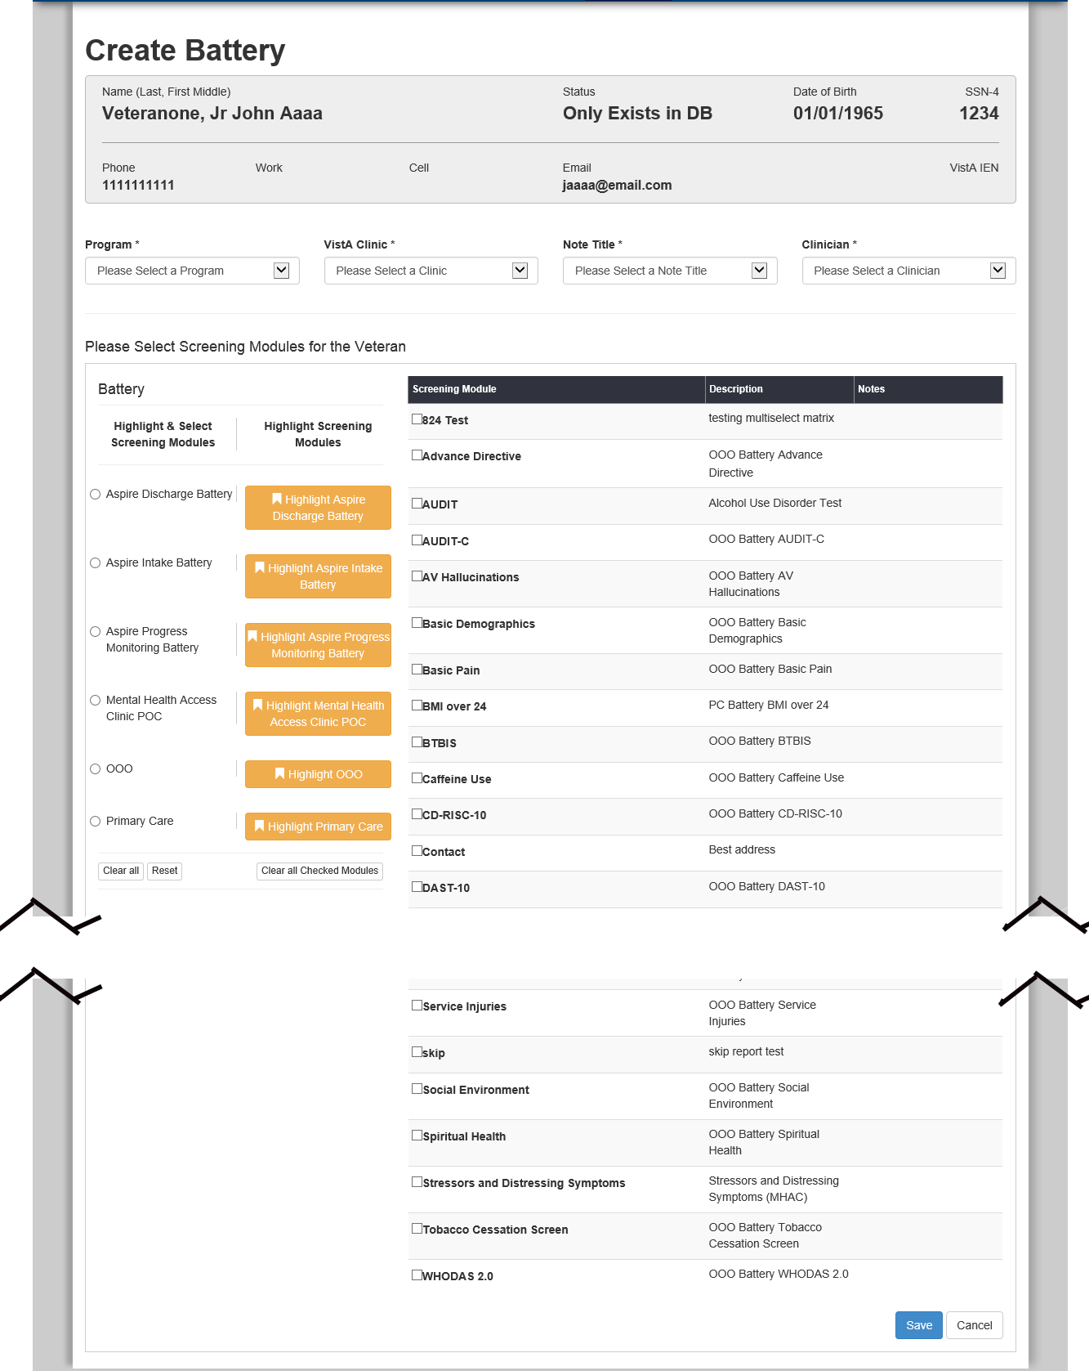
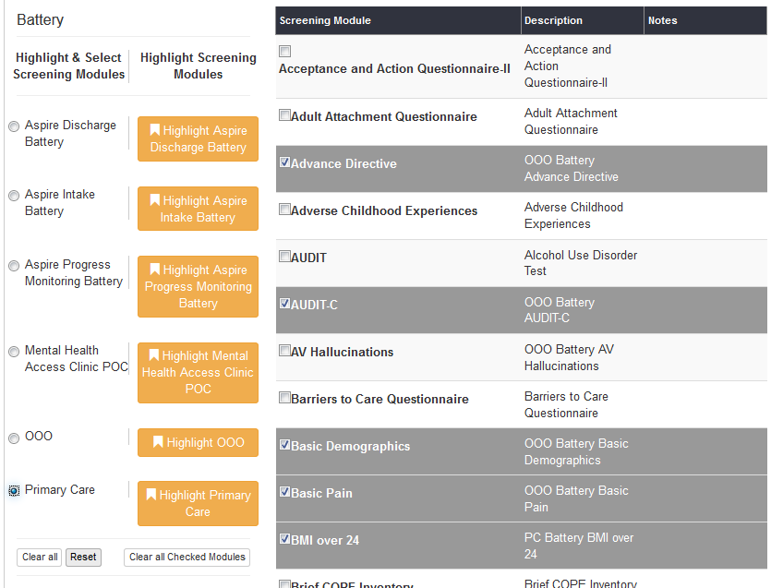
Creating an assessment For a walk-in Veteran
Notes:
Click the option button that you want; it highlights and selects the screening modules that apply to that battery.
Above right, the Primary Care option button was selected, and Primary Care modules are highlighted and selected. Often, clicking one option button is all that you will do.
If you want to design additional modules into your new battery, or remove any, check or clear those check boxes accordingly.
The Clear all button clears option buttons, unchecks checkboxes, and removes highlighting.
The Reset button reverts all changes you have made.
The Clear all Checked Modules button unchecks checkboxes, and removes highlighting.

Slide 42
Creating an assessment For a walk-in Veteran
Notes:
Click Save. You’re done!
All batteries you create will appear in the Batteries list on the Veteran’s Veteran Detail page.
The system is ready to accept input from the Veteran’s tablet as soon as the Veteran logs in.

Slide 43
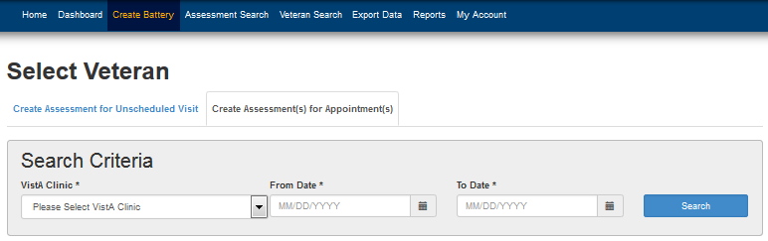
Creating assessments for appointments
Notes:
The second tab on this page is for creating assessments by the batch for the next day’s appointments.
From the Home page, click Create Battery. The Create Battery page opens to the Create Assessment for Unscheduled Visit tab.
Click Create Assessments for Appointments. That tab opens.

Slide 44
Creating assessments for appointments
Notes:
Click the drop-down lists to select your clinic, and From and To dates. Then click Search.
Results will display a list of Veterans who have appointments at that clinic, within that range.

Slide 45
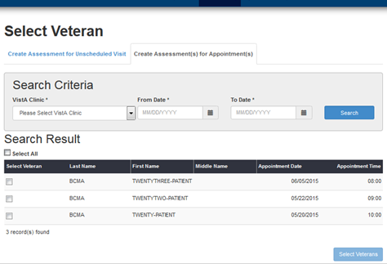
Creating assessments for appointments
Notes:
Click to select the check boxes of the Veterans you want to include, then click the Select Veterans button.
The Create Battery page opens showing the selected Veterans at the top.

Slide 46
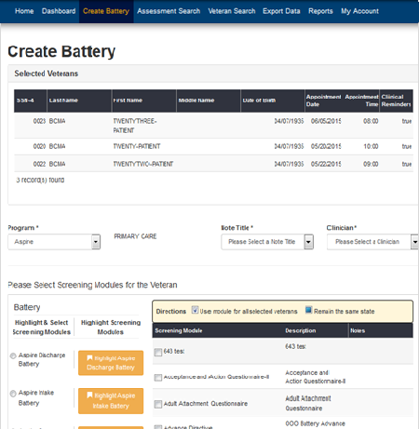
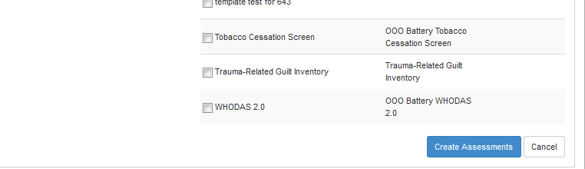
Creating assessments for appointments
Notes:
Select the screening modules you want, then click Create Assessments (bottom of page).

Slide 47
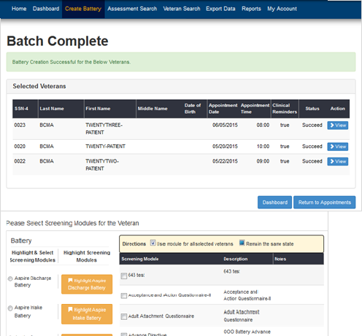
Creating assessments for appointments
Notes:
A banner tells you that the assessments were created successfully.
You can also create multiple assessments for a Veteran within 48 hours. MHE supports one assessment in each clinic daily for a given Veteran. This allows a Veteran, for example, to have an appointment in a Mental Health clinic in the morning, and an afternoon appointment in Primary Care, and an assessment can be created for each appointment.
Some of the same modules are used in different assessments. If a module’s questions have been answered, and the module is used in a new assessment within 48 hours, the system will recognize it as a duplicate and copy the answers to the new assessment. The Veteran will not have to answer those questions again for any appointments within 2 days.

Slide 48
MHE Creating assessments kklklj Self-Review question
What is the difference between batteries and assessments?
Nothing; batteries and assessments are two names for the same thing.
Batteries refer to walk-ins; assessments are for appointments.
Veterans are only given assessments.
Veterans are only given batteries.

Slide 49
MHE Creating assessments kklklj Self-Review answer
What is the difference between batteries and assessments?
Nothing; batteries and assessments are two names for the same thing.
Batteries refer to walk-ins; assessments are for appointments.
Veterans are only given assessments.
Veterans are only given batteries.

Slide 50
MHE Creating assessments kklklj Self-Review question
What statements are true about creating an assessment?
A Veteran must have a record in the MHE database before you can create an assessment.
You can create single assessments for walk-in Veterans, or a batch for appointments.
If you can’t find a Veteran’s record, you can create one.
You can design additional modules into your assessment, or remove ones that you don’t want.

Slide 51
MHE Creating assessments kklklj Self-Review answer
What statements are true about creating an assessment?
A Veteran must have a record in the MHE database before you can create an assessment.
You can create single assessments for walk-in Veterans, or a batch for appointments.
If you can’t find a Veteran’s record, you can create one.
You can design additional modules into your assessment, or remove ones that you don’t want.

Slide 52
MHE Clinician & Assistant training
Access
Your tasks
What the Veteran sees
Creating assessments
The Assessment Dashboard
Searches
Reports
Getting help

Slide 53
The Assessment Dashboard
From the dashboard, you can:
monitor the status of all assessments, including real-time alerts
update the status of individual assessments
change an individual’s VistA clinic, Note title, and clinician
view and print the eScreening Veteran Summary
view individual assessments and health factor titles
save to VistA
Notes:
We will look at each of these.

Slide 54
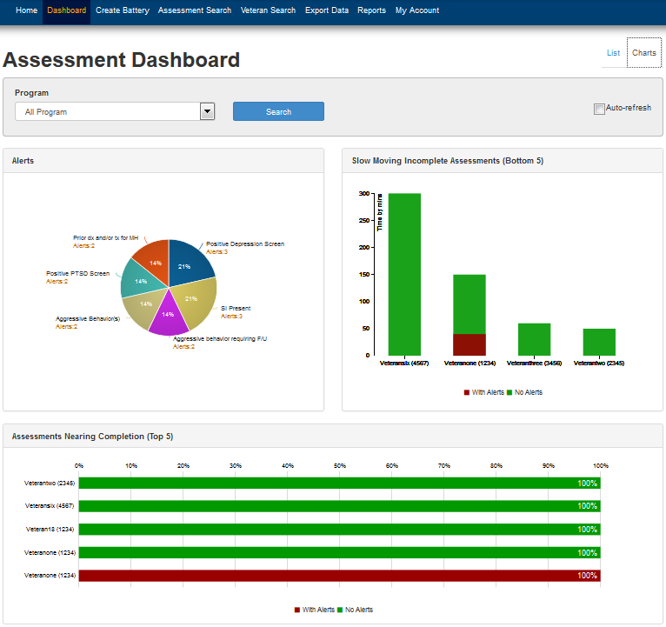
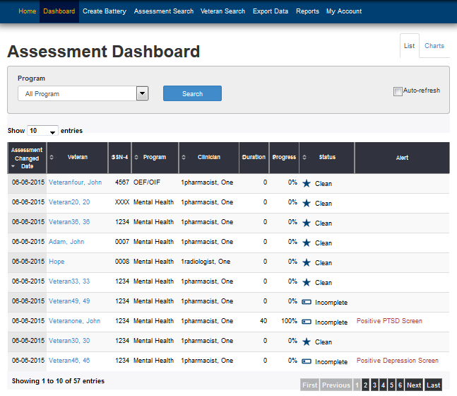
The Assessment Dashboard – you can:
View the dashboard or Chart view: in List view:
Notes:
Click to select the Auto-refresh check box (circled) so that the page will refresh every minute.
You can search by Program in either view.
List view allows you to click and select individual Veteran records.
You can sort the list by clicking the arrow icons on the column titles.

Slide 55
The Assessment Dashboard – you can:
monitor the status of all assessments, including real-time alerts
Notes:
Any alerts generated by Veterans answering outside of clinician-set parameters will appear in the alert column in red text.
Note: You cannot sort the list by the Alert column. In order to make sure that you don’t miss any alerts, set the number of entries shown on the page to a larger number than the total entries.
In the example above, the page is only showing 1-10 of 57 entries. This page could be set to show 100 entries, which would encompass all potential alerts.

Slide 56
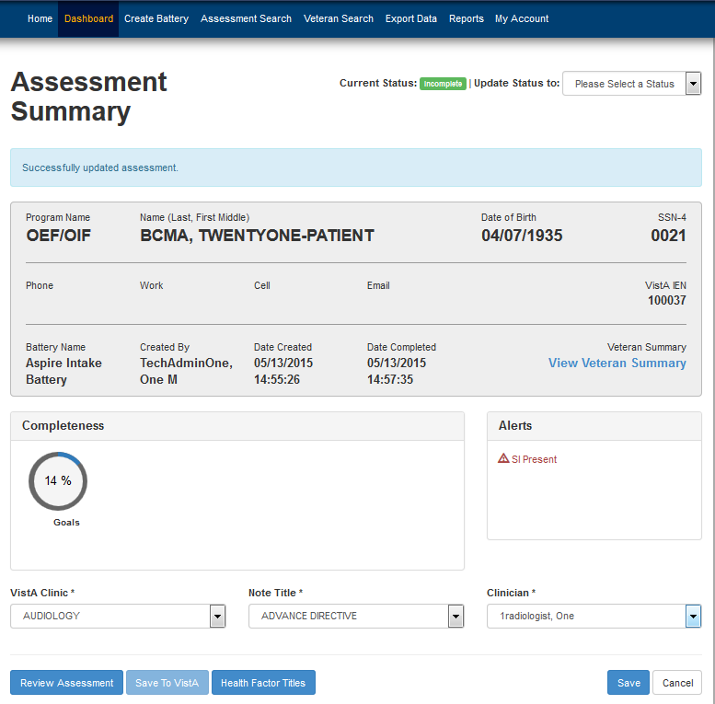
Assessment Dashboard - you can:
update the status of individual assessments
Notes:
Click a Veteran’s name in the list view of the Assessment Dashboard page. The Assessment Summary page opens for the Veteran you chose (above).
Click the list to change the status.
Choices are:
Incomplete
Complete
Deleted

Slide 57
Assessment Dashboard - you can:
change a Veteran’s VistA clinic, Note title, and clinician
Notes:
Click the list arrows and select your options, then click Save. The system saves your selections.

Slide 58
Assessment Dashboard - you can:
view and print the eScreening Veteran Summary
Notes:
Click View Veteran Summary (arrow). The eScreening Summary pop-up window opens.

Slide 59
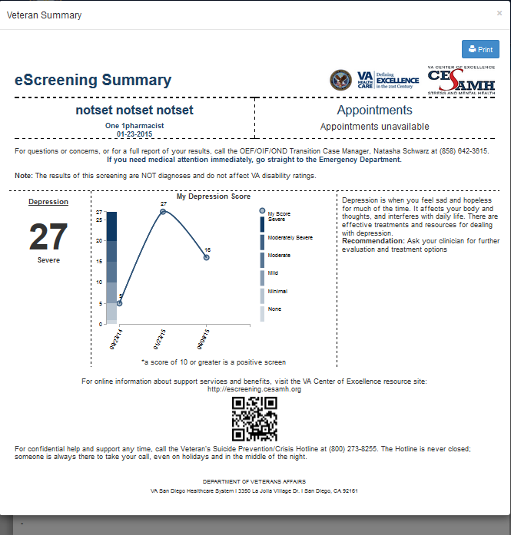
Assessment Dashboard
Notes:
If you want to print the summary, click Print.

Slide 60
Assessment Dashboard - you can:
view individual assessments and health factor titles
Notes:
Click Review Assessment or Health Factor Titles. The Review Assessment Preview or the Health Factor Titles pop-up window opens.

Slide 61
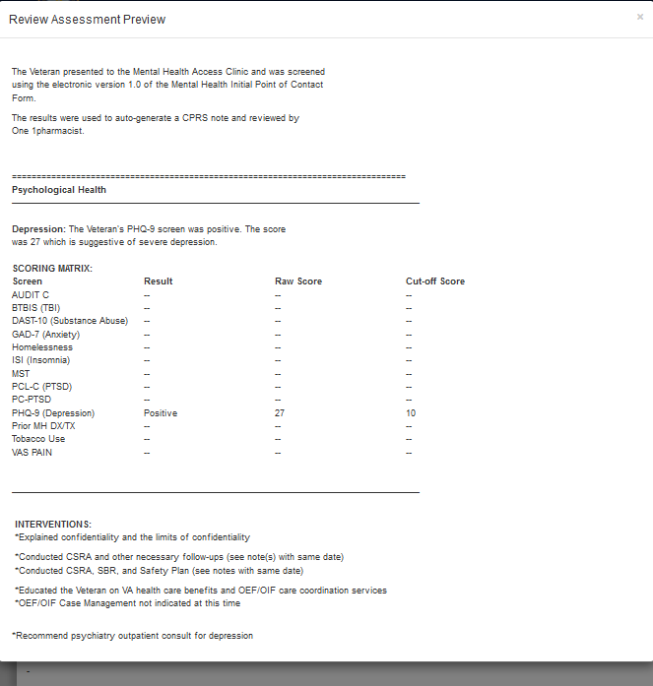
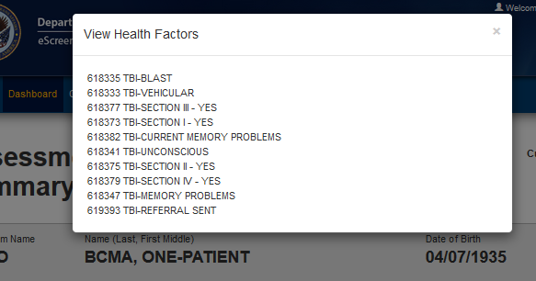
Assessment Dashboard
Notes:
Review Assessment Preview pop-up window, and Health Factor Titles pop-up window.

Slide 62
Assessment Dashboard - you can:
save to VistA
Notes:
Saving to VistA is critical. This is where the data gathered by MHE is logged into the VA record system, CPRS and VistA.
From the Assessment Summary page, click Save to VistA. After the system asks for confirmation, click Save. If the Save to VistA button is unavailable, as shown above, it may be because the record has already been saved. Alternately, the Save to VistA button may be unavailable because the record requires mapping first. If the Map to VistA link is available, you must click it. Mapping to VistA is necessary for assessments that were not mapped during creation. This is so that MHE can upload to the correct medical record.
After mapping is performed, the Save to VistA button becomes available.
If offered the link, always Map to VistA before saving to VistA. In the example above, the Map to VistA link is not shown, so it is not a concern.

Slide 63
Assessment Dashboard Self-Review question
The assessment dashboard allows you to …
monitor assessment progress and view alerts.
review completed assessments.
publish generated reports to VistA and CPRS.
All above statements are true.

Slide 64
Assessment Dashboard Self-Review answer
The assessment dashboard allows you to …
monitor assessment progress and view alerts.
review completed assessments.
publish generated reports to VistA and CPRS.
All above statements are true.

Slide 65
MHE Clinician & Assistant training
Access
Your tasks
What the Veteran sees
Creating assessments
The Assessment Dashboard
Searches
Reports
Getting help

Slide 66
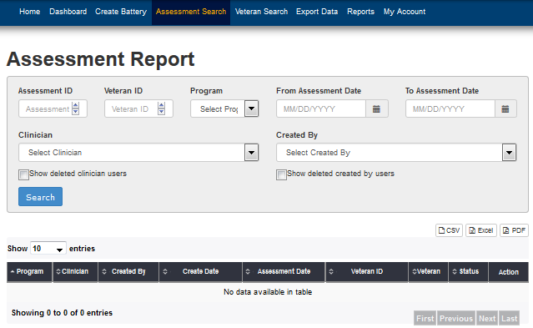
Searching for Veterans and Assessments
Notes:
Clicking Assessment Search on the main menu opens the Assessment Report page.
This page has fields, clickable lists, From and To calendars, and check boxes for inputting your search terms.

Slide 67
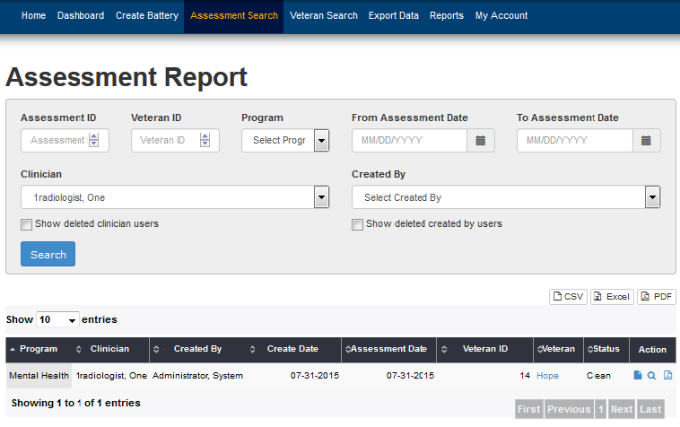
Searching for Veterans and Assessments
Notes:
The Assessment Report page:
A search by Clinician displays one result in the example above.

Slide 68
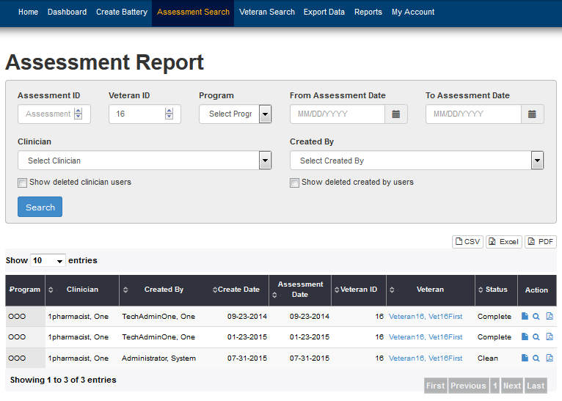
Searching for Veterans and Assessments
Notes:
The Assessment Report page:
A search by Veteran ID displays this test Veteran with 3 assessments in the system. Group results can be exported, viewed, and printed in CSV, Excel, and PDF formats.
Enter your search parameters, then click Search. Search results display in the lower part of the page.
Click CSV, Excel, or PDF, as shown in the box above. You may be asked to choose a helper application to open the results.

Slide 69

Searching for Veterans and Assessments
Notes:
The Assessment Report page:
Individual results display icons in the Action column for viewing the assessment, the review notes, and the audit log.
paper icon = assessment
magnifying glass = review notes
PDF = audit log
We’ll show each of these options.

Slide 70
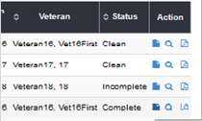
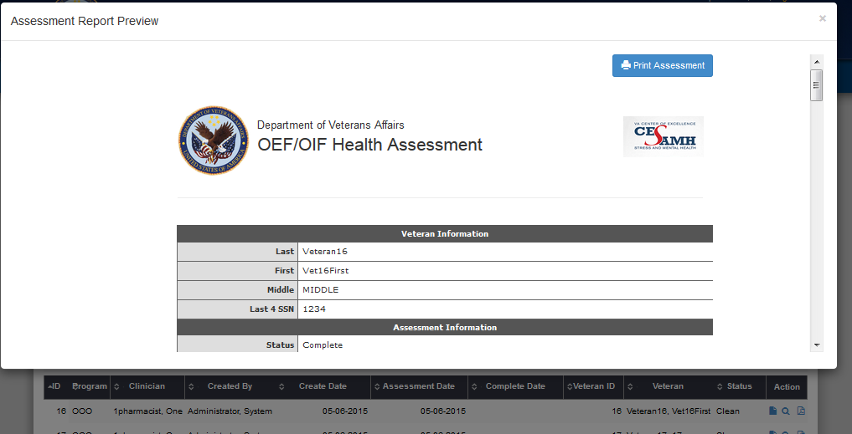
Searching for Veterans and Assessments
Click the paper icon in the Action column and row for the Veteran’s results you want.
The Assessment Report Preview opens.
Notes:
The Assessment Report page:
paper icon = assessment

Slide 71
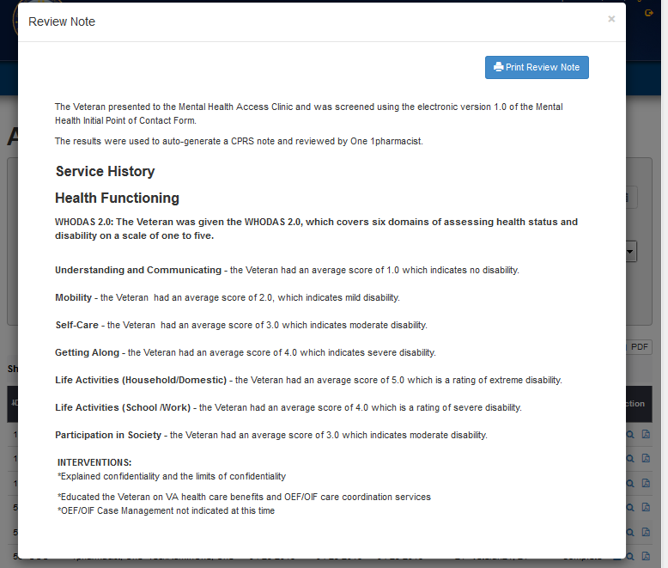
Searching for Veterans and Assessments
Click the magnifying glass icon in the Action column and row for the Veteran’s results you want.
The Review Note opens.
Notes:
The Assessment Report page:
magnifying glass icon = review notes

Slide 72
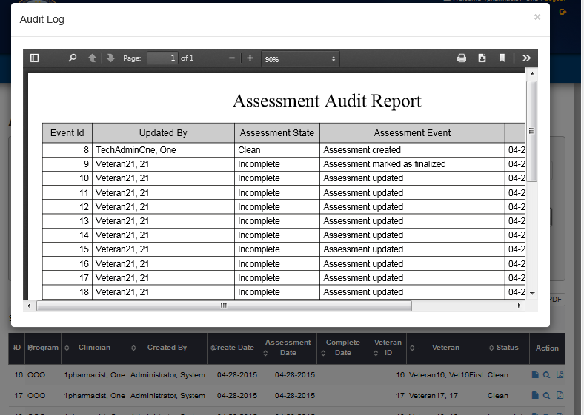
Searching for Veterans and Assessments
Click the PDF icon in the Action column and row for the Veteran’s results you want.
The Assessment Audit Report opens.
Notes:
The Assessment Report page:
PDF icon = audit report

Slide 73
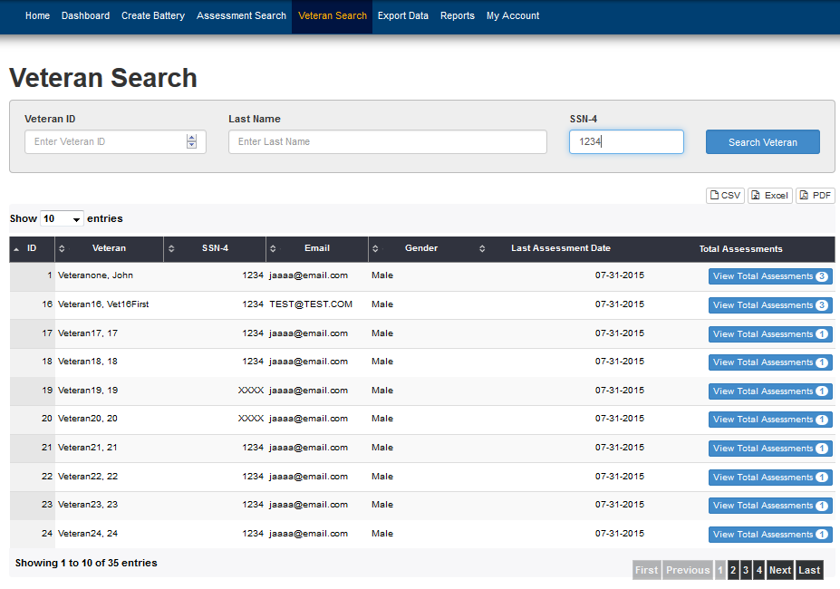
Searching for Veterans and Assessments
Clicking Veteran Search on the main menu opens the Veteran Search page.
Notes:
The Veteran Search page has fields and check boxes for inputting your search terms. Group results can be exported, viewed, and printed in CSV, Excel, and PDF formats.
Individual results display a View Total Assessments button for viewing all assessments that have been created for the Veteran. Clicking the button takes you directly to the Assessment Report.

Slide 74
Searches Self-Review question
The Assessment Search and Veteran Search tabs allow you to …
View a list of Veterans with assessments created by a particular clinician.
View the number of assessments created for a particular Veteran.
See Review Notes from CPRS.
Perform any of the above listed actions.

Slide 75
Searches Self-Review answer
The Assessment Search and Veteran Search tabs allow you to …
View a list of Veterans with assessments created by a particular clinician.
View the number of assessments created for a particular Veteran.
See Review Notes from CPRS.
Perform any of the above listed actions.

Slide 76
MHE Clinician & Assistant training
Access
Your tasks
What the Veteran sees
Creating assessments
The Assessment Dashboard
Searches
Reports
Getting help

Slide 77
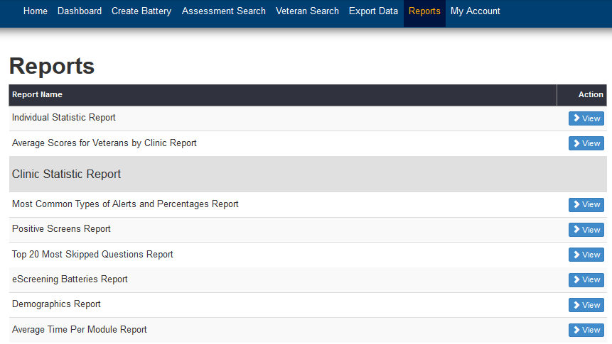
Reports
You can generate reports and print them.

Slide 78
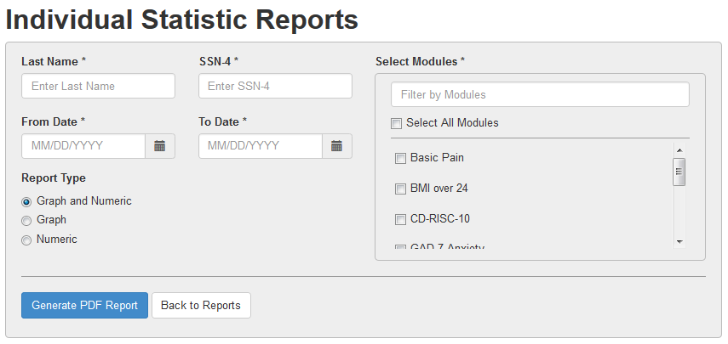
Reports
This is a report form ready for your input:

Slide 79
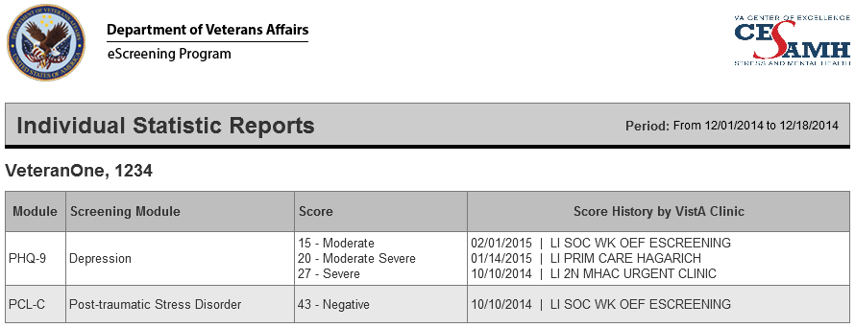
Reports
This is a typical report output:

Slide 80
MHE Clinician & Assistant training
Access
Your tasks
What the Veteran sees
Creating assessments
The Assessment Dashboard
Searches
Reports
Getting help

Slide 81
How to get help
Refer to the User Training Guide.
For general troubleshooting, contact your site’s Healthcare System Technical Administrator, or contact:
Liz Floto
858-552-8585 Ext. 5550
Elizabeth.floto@va.gov
Matthew Morgan 858-552-8585 ext.5557
Matthew.Morgan@va.gov

Slide 82
Questions?
? ? ? ???????? ??????????????
? ? ? ? ? ? ? ? ? ? ? ? ? ?? ? ? ? ? ??????????????????????????????????????????????????????????????????????????????????? ???? ???? ???? ???? ???????? ???? ???? ????
? ? ? ? ? ? ? ? ? ? ? ? ? ? ? ? ? ? ? ? ? ???????????????????????????? ?????????????????????????????????????? ? ? ? ? ? ? ? ? ? ? ? ? ? ? ? ? ? ? ? ? ? ? ? ? ? ? ?? ? ? ? ? ? ? ? ? ? ? ? ? ? ? ? ? ? ? ? ??? ??? ??? ??? ?????? ??? ??? ??????????????????????????????????????????????????????? ???? ???? ????????? ??? ?????????
??????????????????????????????????

Slide 83
Congratulations!
You have completed
Mental Health eScreening Clinician & Assistant Training

